Slide 1
Rare and Non-Standard Model Decays of the Higgs Boson
Ashish Sehrawat
MSc. Physics IIT Indore

Slide 2
Outline
Basics of pp Collider Physics.
Particles Produced at the pp collider.
Rare and Non-Standard Model decays of Higgs Boson.
Charged Higgs Boson Decay in SUSY Models.
Conclusions.

Slide 3
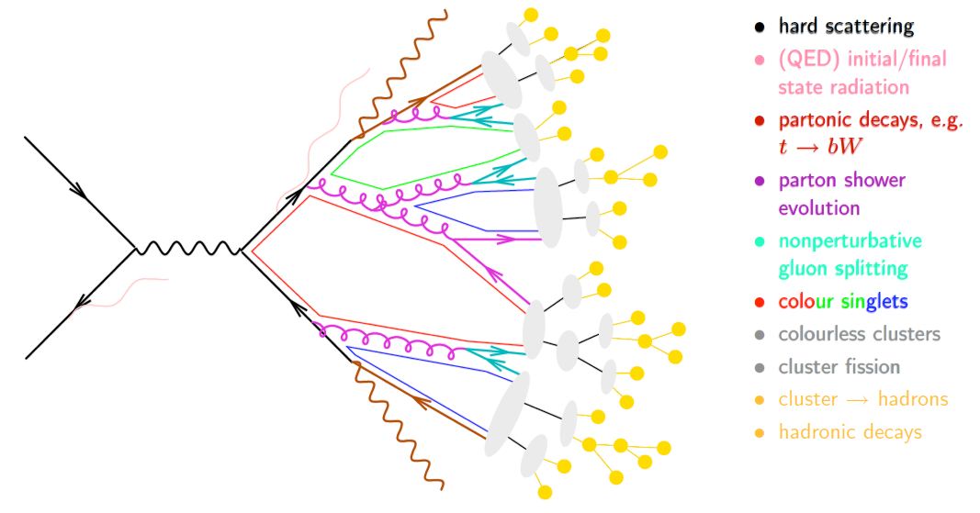

Slide 4
pp collisions
cross- sectional area σ.
n is the number of particle per unit volume of the target, A is the geometrical area of the target
Probability of scattering from the target is
Number of particles hitting on the target be N_{t}
Number of scattered particles N_{s} = N_{t} =

Slide 5
Cross sectional area
Differential cross section
Inclusive cross section
Exclusive cross section
Unit of cross section area 1b=10⁻²⁴ cm² = 10⁻²⁸ cm²

Slide 6
Some common cross sectional area are
Proton-proton inelastic collision at LHC 50 mb at 7 TeV
Higgs Boson production at Large Hadron Collider (LHC) 20 pb
Heavy nuclei cross section 1 b
W/Z boson production at LHC 50 nb

Slide 7
Collider luminosity
Integrated Luminosity
Bunch crossing frequency
Number of particles in beam 1 and 2 are
and
is the geometrical area of the beam.

Slide 8
Rapidity
Rapidity for
massless particles
Pseudorapidity

Slide 9
Particles after collision
neutrinos
electron
muon
tau
u, d, s, c, b quarks and gluons hadronizes to give
jets of colorless bound states, hadrons which are
top quark decays before it hadronizes
W, Z, H decays instantly

Slide 10
Basics of Statistics at LHC
Signal strength µ
Test statistic q
Excess quantification
p-value
Significance
Best fit value of µ or û
Lack of excess quantification
CL_{s} value and CL
Limit on µ

Slide 11
Expected background rate b, expected signal rate s₀, observed events n_{obs}
p=P(n n_{obs}|b) is the p-value
p-value | 0.16 | 0.023 | 1.3 ×10⁻³ | 3.2 ×10⁻⁵ | 2.9 ×10⁻⁷
Z | 1 | 2 | 3 | 4 | 5
Standard model Higgs boson event rate s₀, higgs boson event rate s=µs₀, µ is the signal strength modifier, L likelihood of observation
Likelihood of observation
Maximizing the likehood
CL: Confidence level when no excess found
Test statistics for Higgs searches

Slide 12
CMS Experiment Trigger Table
Trigger | Theshold Energy (GeV) | Rate (kHz)
Single µ | 14 | 7
Single e/ƴ | 20 | 13
e/ƴ+µ | 12,3.5 | 3
Single jet | 128 | 1.5
Quad jet | 36 | 5
E_{T}^{miss} | 40 | 8

Slide 13
Particle | Transverse momentum and trigger frequency
µ | p_{T}>24 (44 Hz)
e | p_{T}>27 (72 Hz)
ee | p_{T}>17/8 (15 Hz)
eµ/µe | p_{T}>17/8 (15 Hz)
ƴƴ | p_{T}>48 (7 Hz)
Single jet | p_{T}>400 (3 Hz)

Slide 14
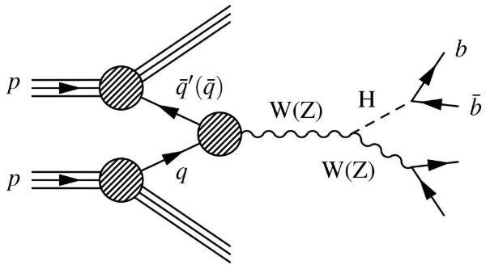
H-> with W or Z boson
Higgs boson production in association with a vector boson V (a W or Z particle), a weak interaction process known as VH(bb)

Slide 15
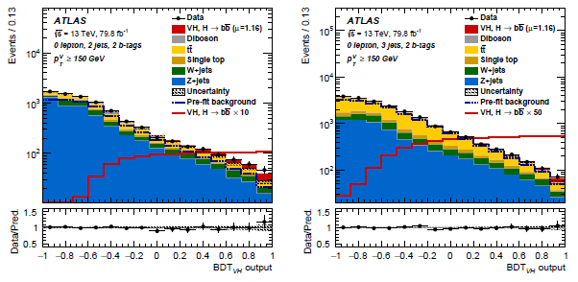
H-> with W or Z boson

Slide 16
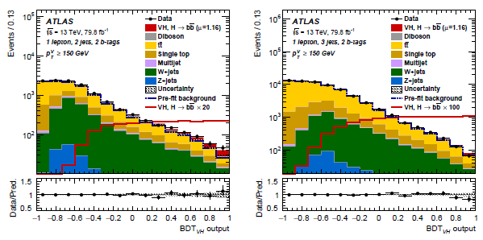

Slide 17
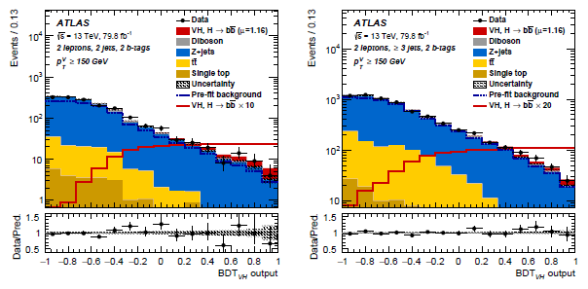

Slide 18
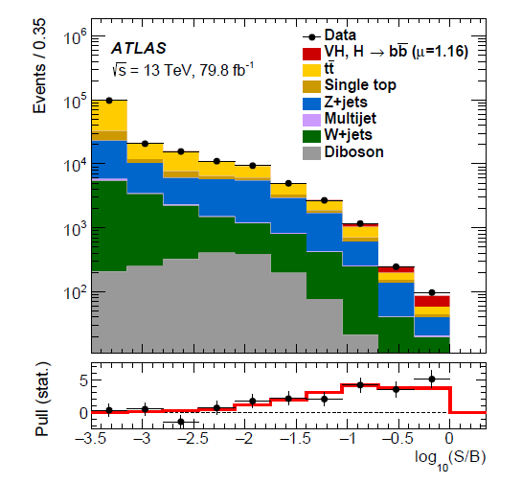
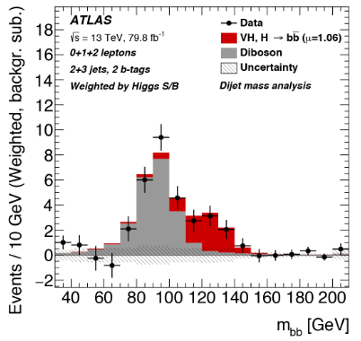

Slide 19
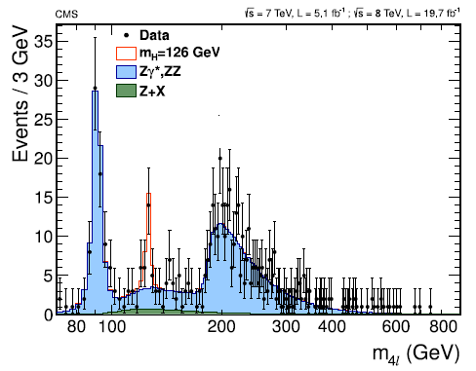
H->ZZ*->

Slide 20
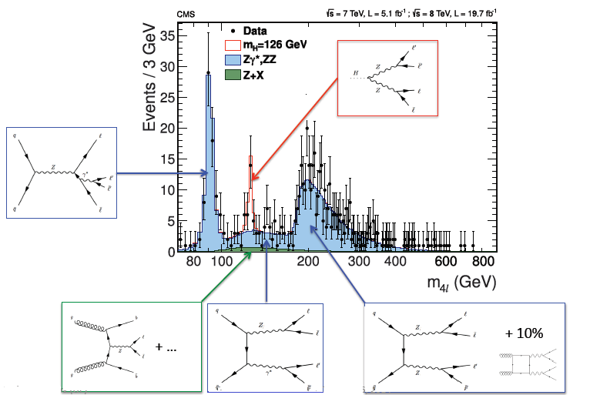

Slide 21
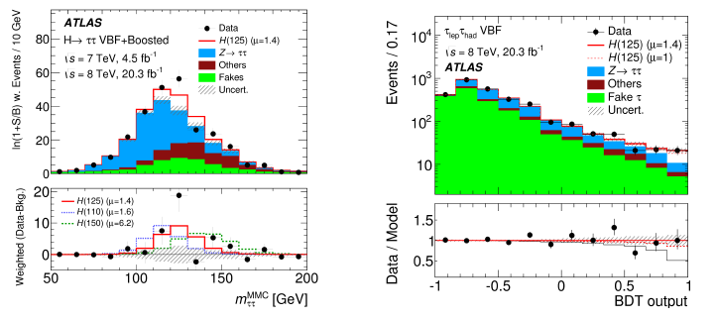
H->ττ

Slide 22
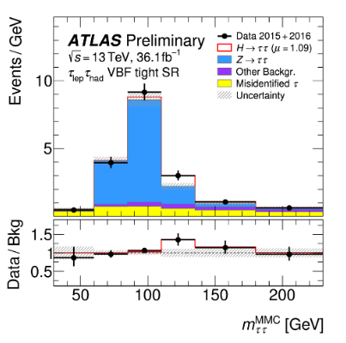
Mass estimator on x-axis with events on y-axis

Slide 23
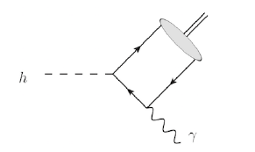
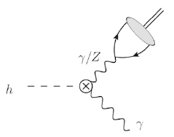
H->Mƴ H: Higgs Boson, M is meson and ƴ is photon
Direct Decay
Indirect Decay

Slide 24
Meson | Branching ratio(BR_{SM}) (H->M ƴ) | Decay mode of meson
ρ | 1.7 × 10⁻⁵ | ρ-> π⁺π⁻
φ | 2.3 ×10⁻⁶ | φ -> µ⁺µ⁻
J/Ѱ | 2.8 ×10⁻⁶ | J/Ѱ ->µ⁺µ⁻
Ƴ(1S,2S,3S) | 6.1,2.0,2.4 × 10⁻¹⁰ | Ƴ -> µ⁺µ⁻

Slide 25
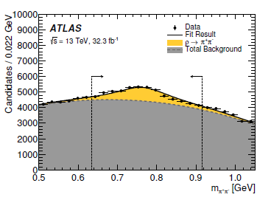
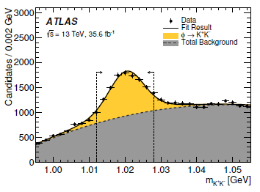
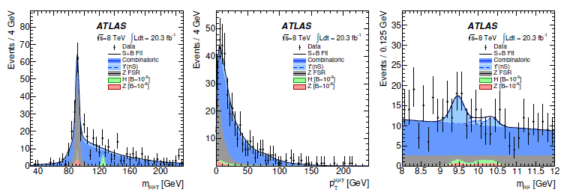
ρ->π⁺π⁻
φ ->K⁺K⁻
m_{µµƴ}
p_{T}^{µµƴ}
m_{µµ}

Slide 26
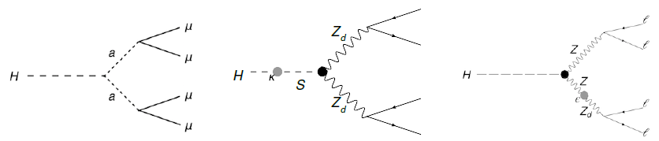
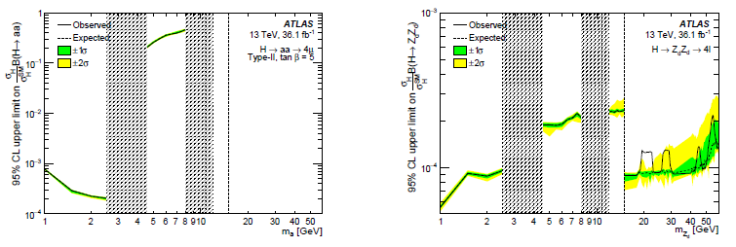
H->a⁰a⁰ and Z_{d}Z_{d}->
a⁰a⁰
Z_{d}Z_{d}
ZZ_{d}
BR (H->a⁰a⁰)
BR (H->Z_{d}Z_{d})

Slide 27
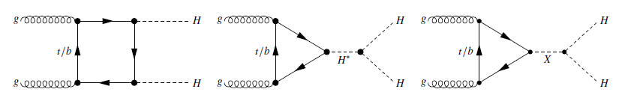
Higgs pair production and decay HH-> , HH->b γγ, HH->WW* ƴƴ
Higgs pair production using gluon-gluon fusion
Heavy quark loop
Higgs self-coupling in standard model
Intermediate resonance X

Slide 28
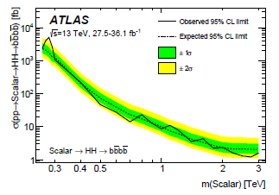
HH ->

Slide 29
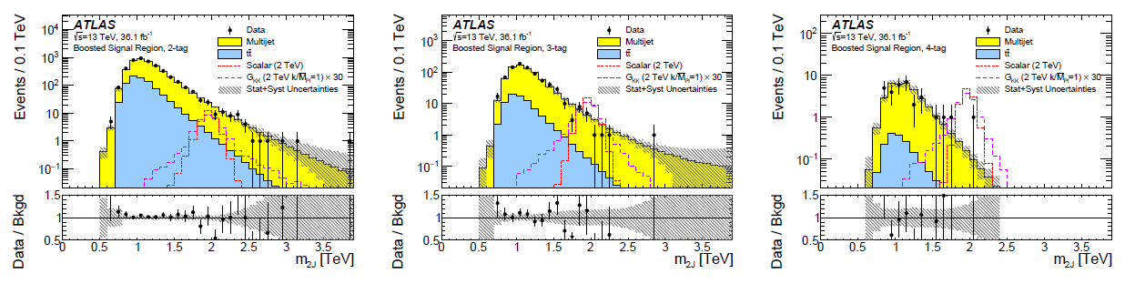
Invariant mass of two split by b-tags

Slide 30
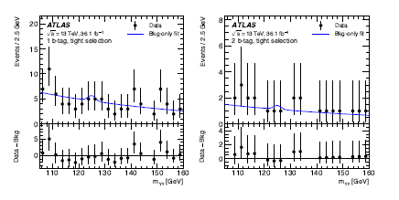
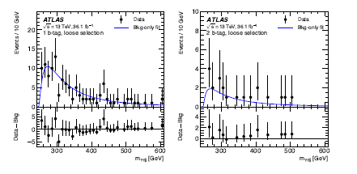
HH -> ƴƴ
Non-resonant production
Resonant production

Slide 31
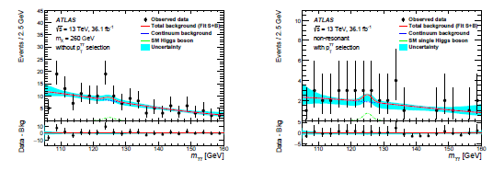
HH -> WW* ƴƴ

Slide 32
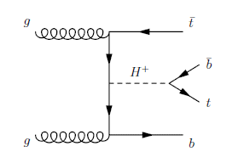
Charged Higgs Boson Decay
Leading order Feynman Diagram for Charged Higgs Boson decay to top and anti-bottom quark

Slide 33
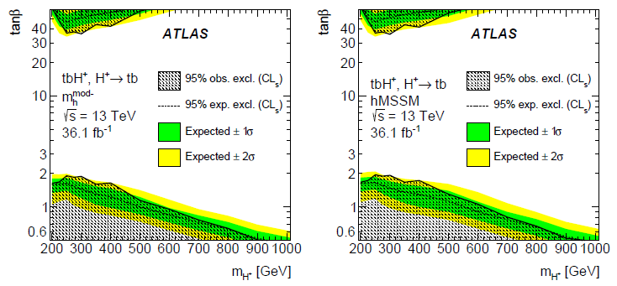
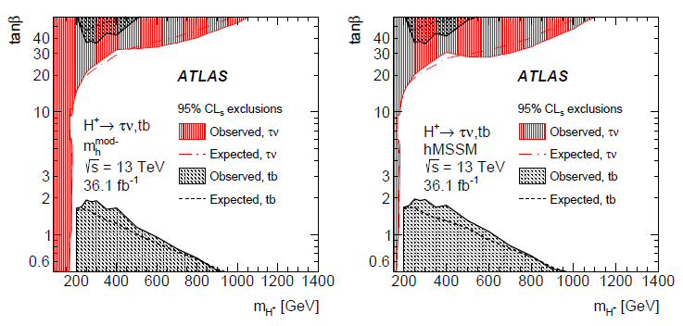

Slide 34
Conclusions
Higgs Boson decay to meson and a photon is vital to be probed at HL-LHC for H-> J/Ѱ γ.
Cross –section of H-> J/Ѱ γ will be 15σ_{SM} at HL-LHC.
Cross section of SM Higgs pair production is 33.41 fb at 13 TeV with decay modes HH-> HH->b γγ, HH->WW* ƴƴ.
The limit on non-resonant Higgs boson pair cross section is 0.223 pb at 95 % CL which is 6.7 and Higgs boson self-coupling to SM coupling at 95 % CL is -5< <12.

Slide 35
Higgs boson can decay to pair and it can be produced with W or Z boson at 13 TeV, 79.8 fb⁻¹ significance 4.9 standard deviation, signal strength
Higgs Boson can decay to bottom quarks H->bb, H->ττ leptons, H-> and H->ZZ*->4l.
Mass estimates of positively charged Higgs Boson is 40-100 GeV for LEP, 80-150 GeV for CDF DǾ and 180-600 GeV for CMS.

Slide 36
The End
Thank you!

